Slide 1


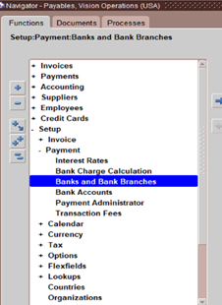
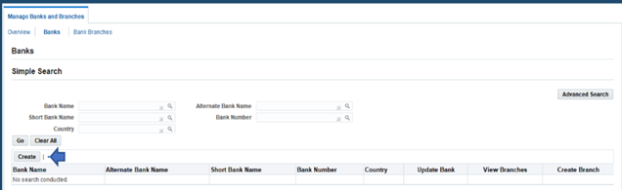
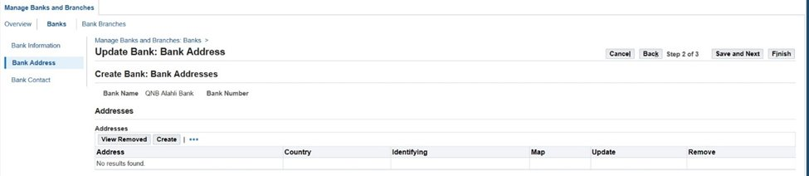
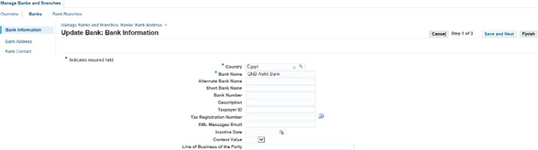
Payment Processing and Cash Management
Steps to set up a Bank:
1)CREATE Bank
2 ) CREATE Branch Name
3 ) CREATE Account Bank
Setup>Payment > Bank and Bank Branches
Bank Information
Create Bank Adress
Bank account created
30

Slide 2
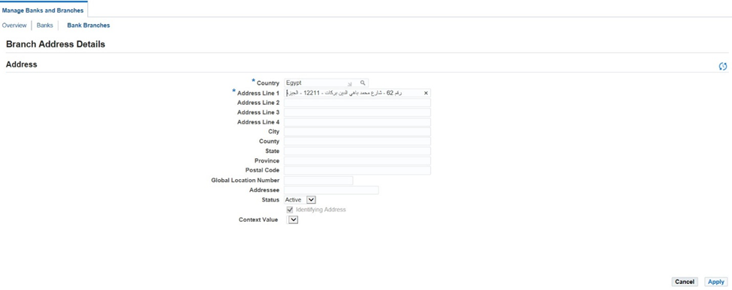
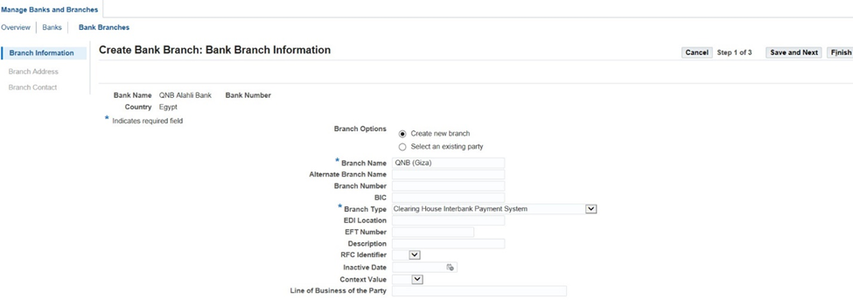
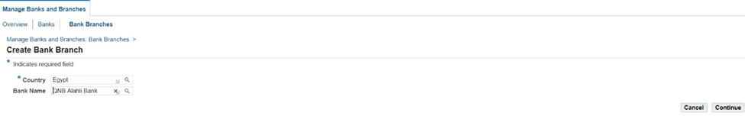
Payment Processing and Cash Management
Steps to set up a Bank:
1)CREATE Bank
2 ) CREATE Branch Name
3 ) CREATE Account Bank
Write Branch Name
Then Enter the address of this Branch
31

Slide 3
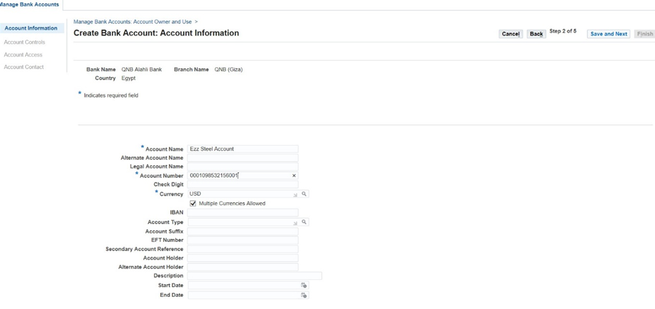
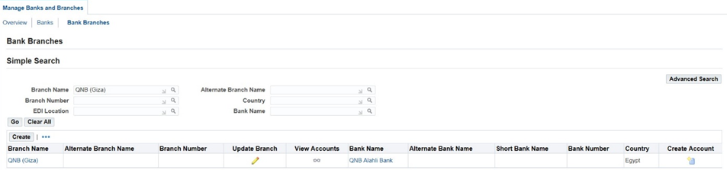
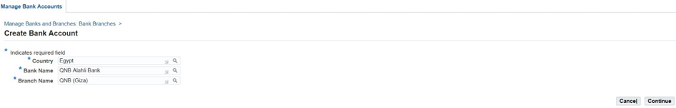
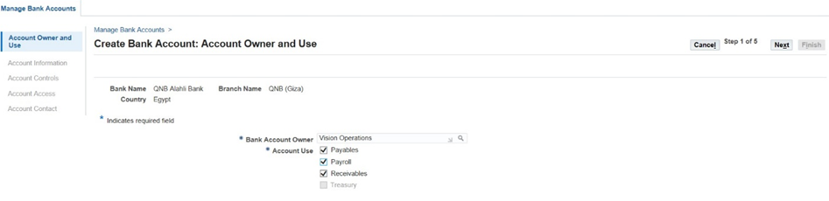
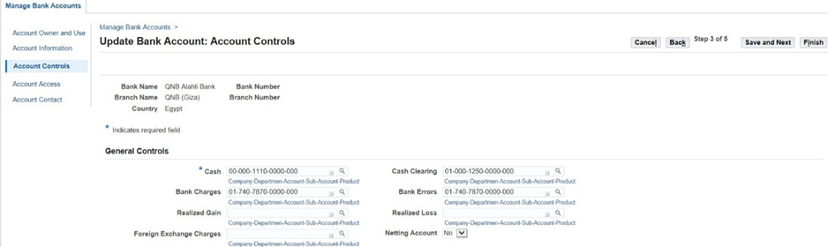
Payment Processing and Cash Management
Steps to set up a Bank:​
1)CREATE Bank​
2 ) CREATE Branch Name ​
3 ) CREATE Account Bank
Click On Create Account
Bank Acc Owner:
• Vision Operation
Write Account Name , Account Number And Currency
32

Slide 4
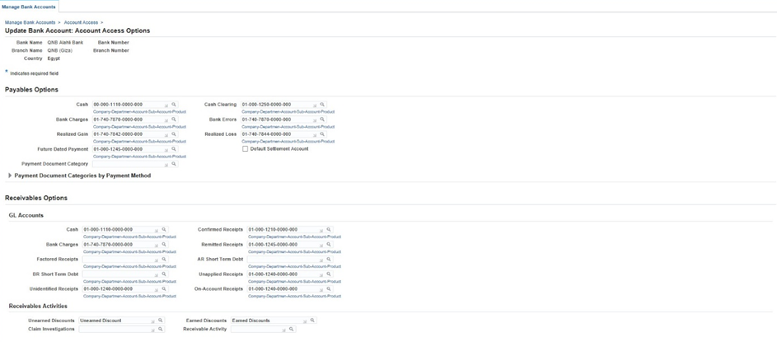
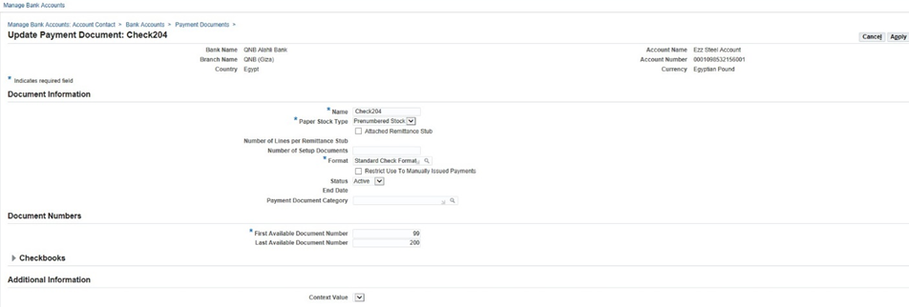
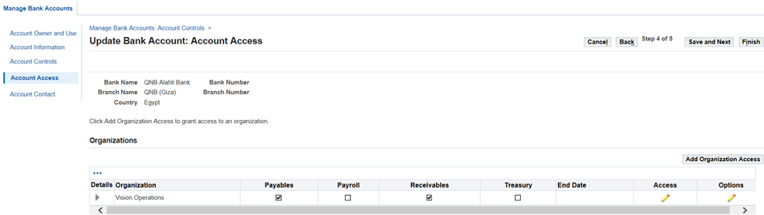
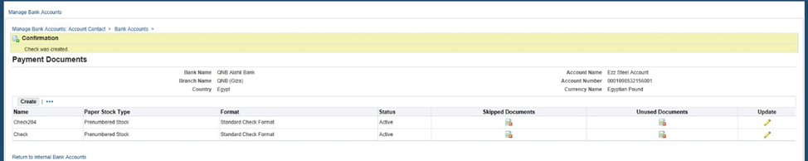
Payment Processing and Cash Management
Choose add organization access
Then create payment document
33

Slide 5
Payment Processing and Cash Management
Apply Payments
There is two ways to pay the invoices
Single Payment Entry
Payment From Work Bench
Involves creating and processing a single payment for specific invoices, used for individual or selected invoices.
Involves processing payments for multiple invoices from a centralized interface, used for handling payments in bulk or batches.
34

Slide 6
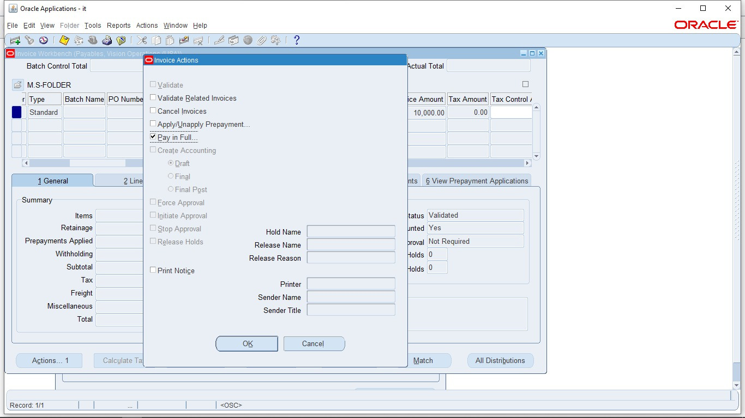
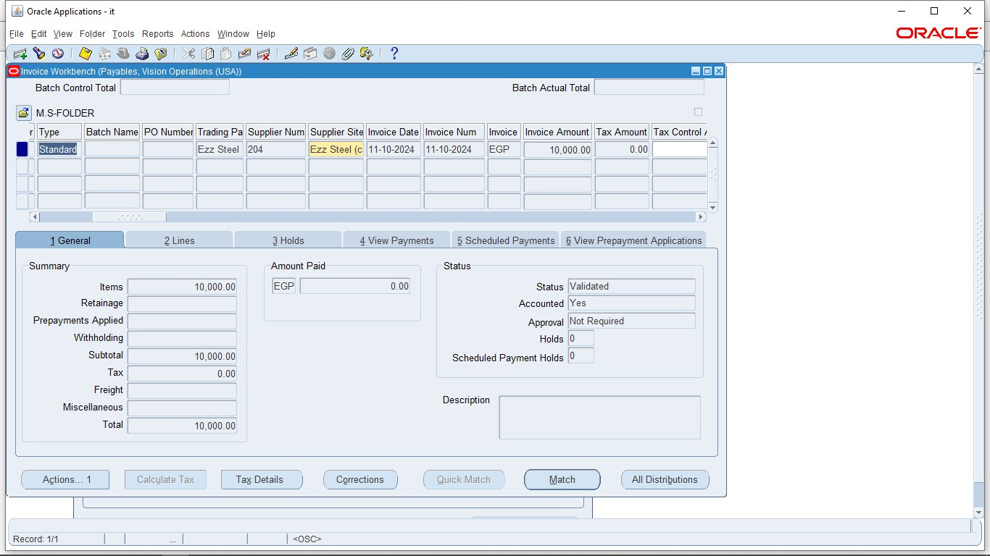
Payment Processing and Cash Management
Apply payments
1- Single Payment Entry
Invoices >Entry >invoices
Identify the invoice you want to pay
Click on Actions ..1 button
Click on Pay In Full > Ok
35

Slide 7
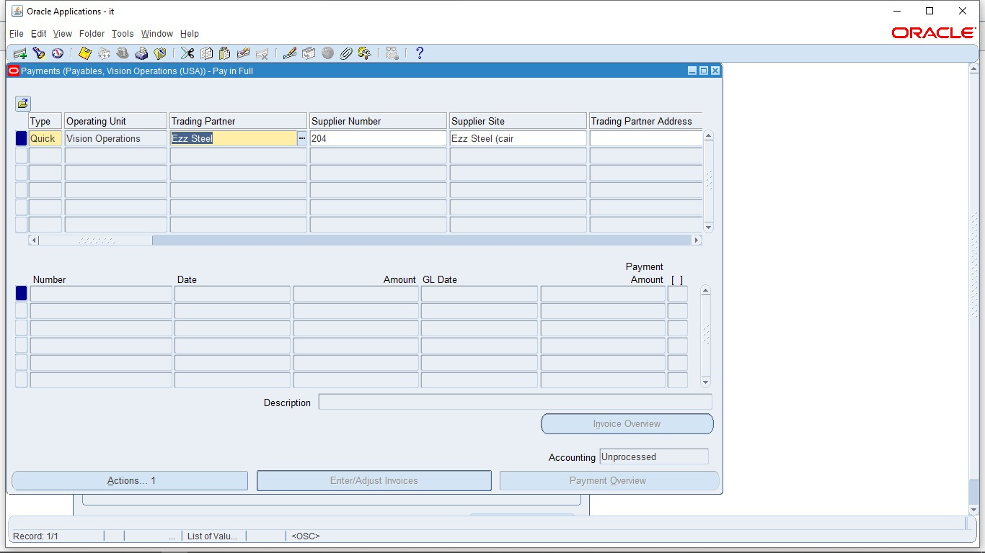
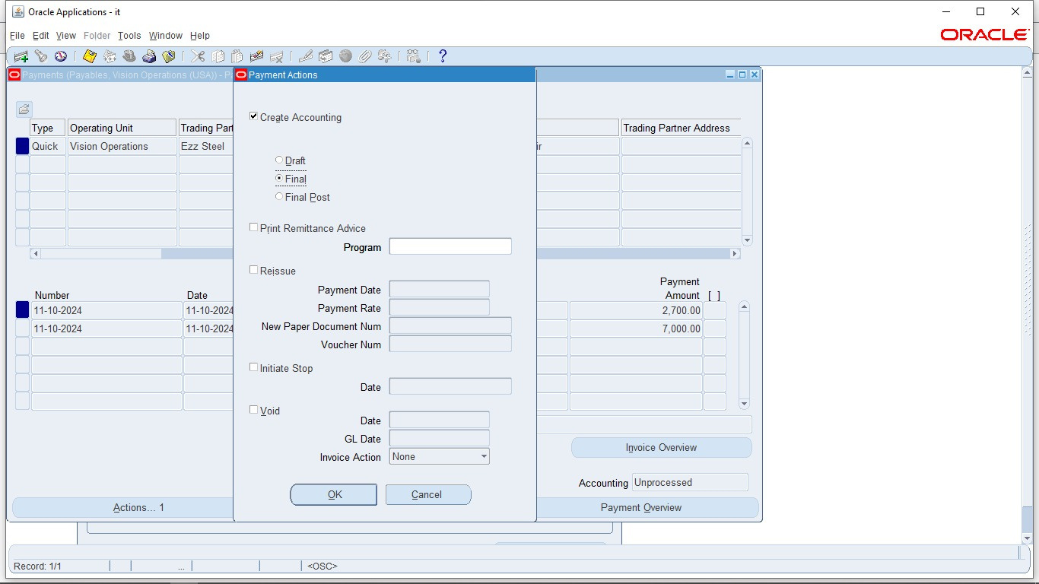
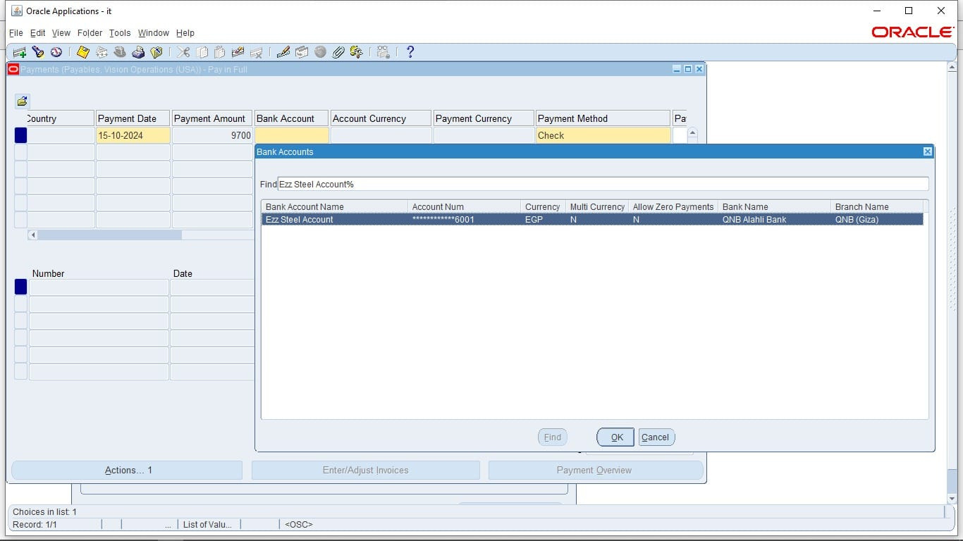
Payment Processing and Cash Management
Apply payments
1- Single Payment Entry
Type: Quick
and enter details required
The payment method: check
Click on Actions ..1
Choose Create Accounting >final >Ok
36

Slide 8
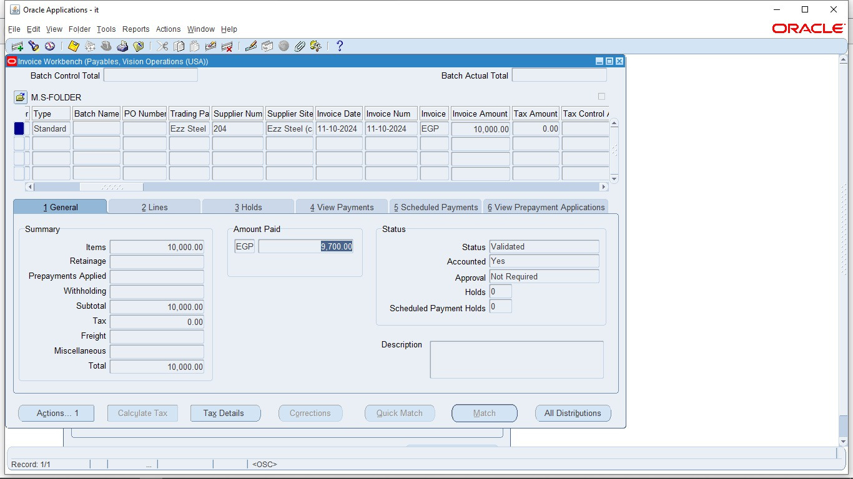
Payment Processing and Cash Management
Apply payments
1- Single Payment Entry
Back to the invoice
Note that total amount paid in a single payment
37

Slide 9
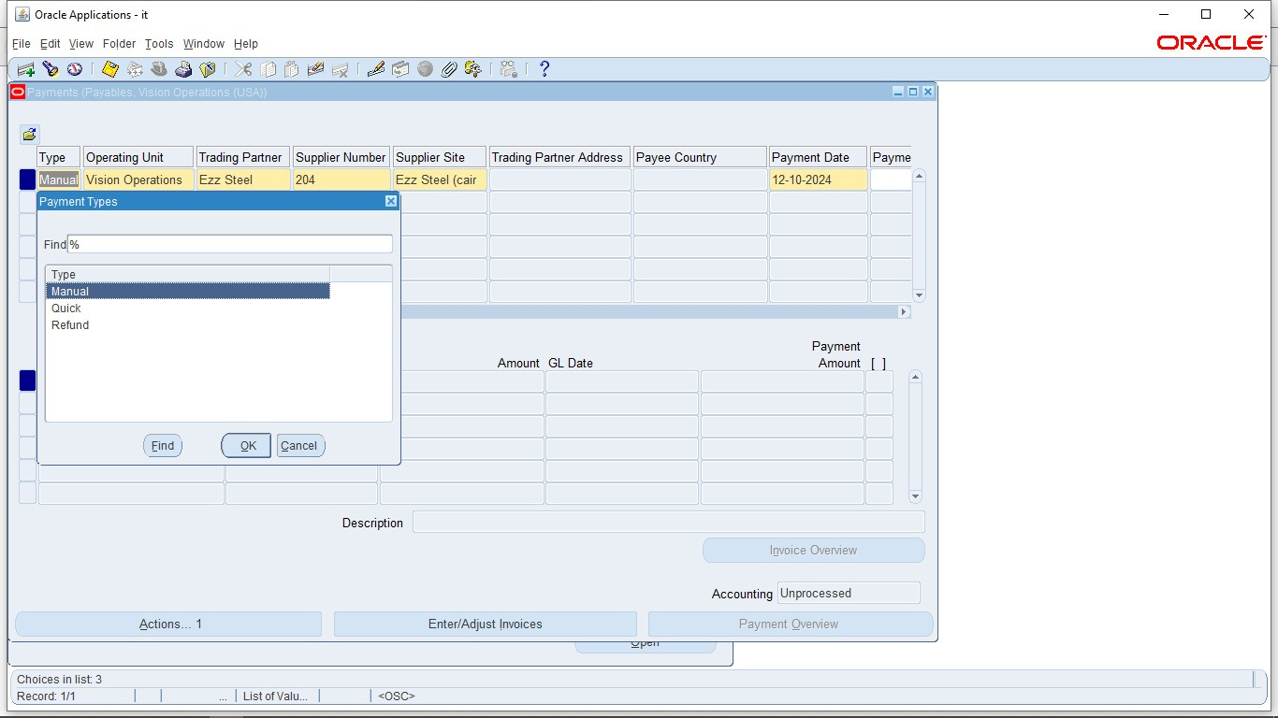
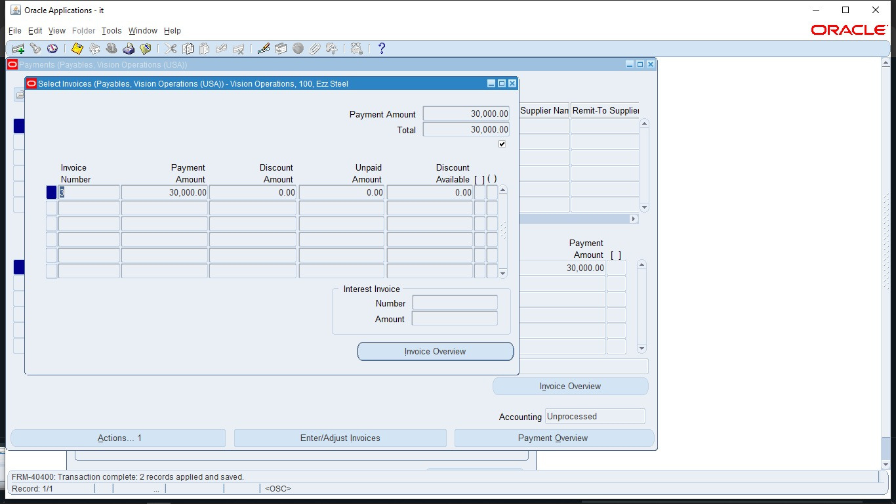
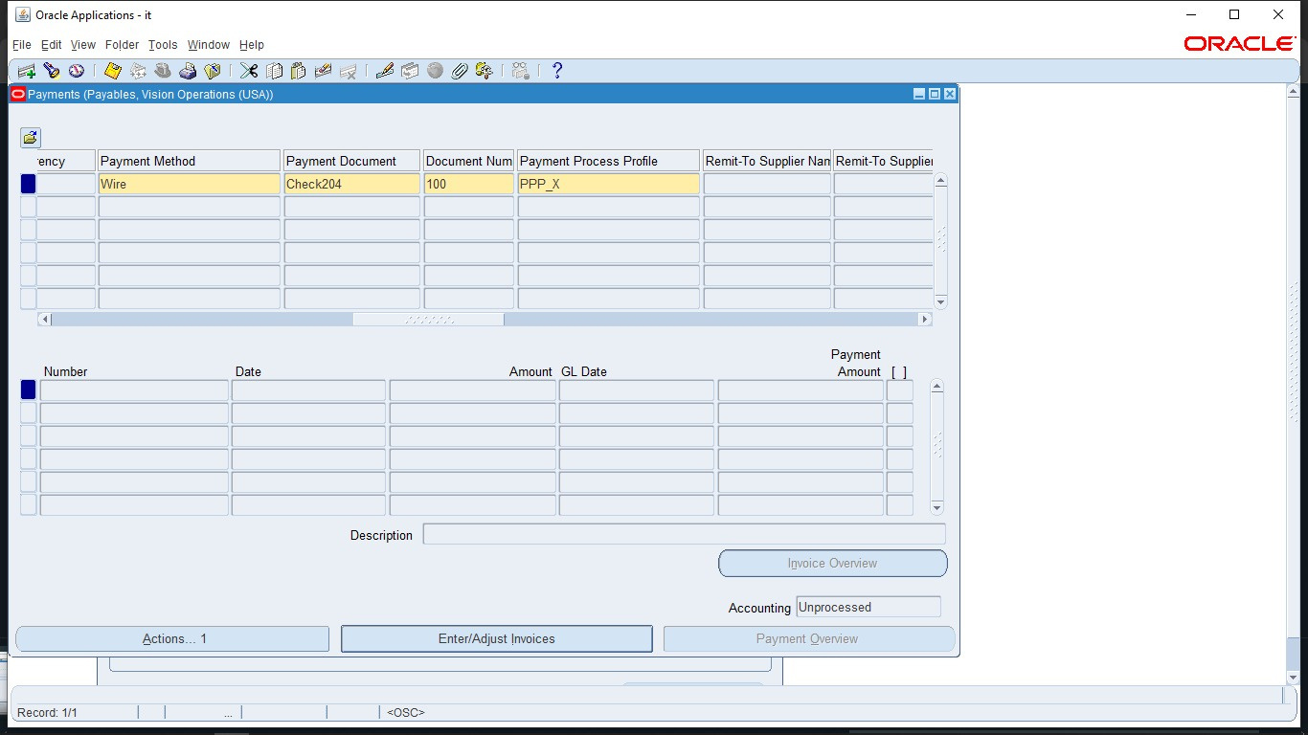
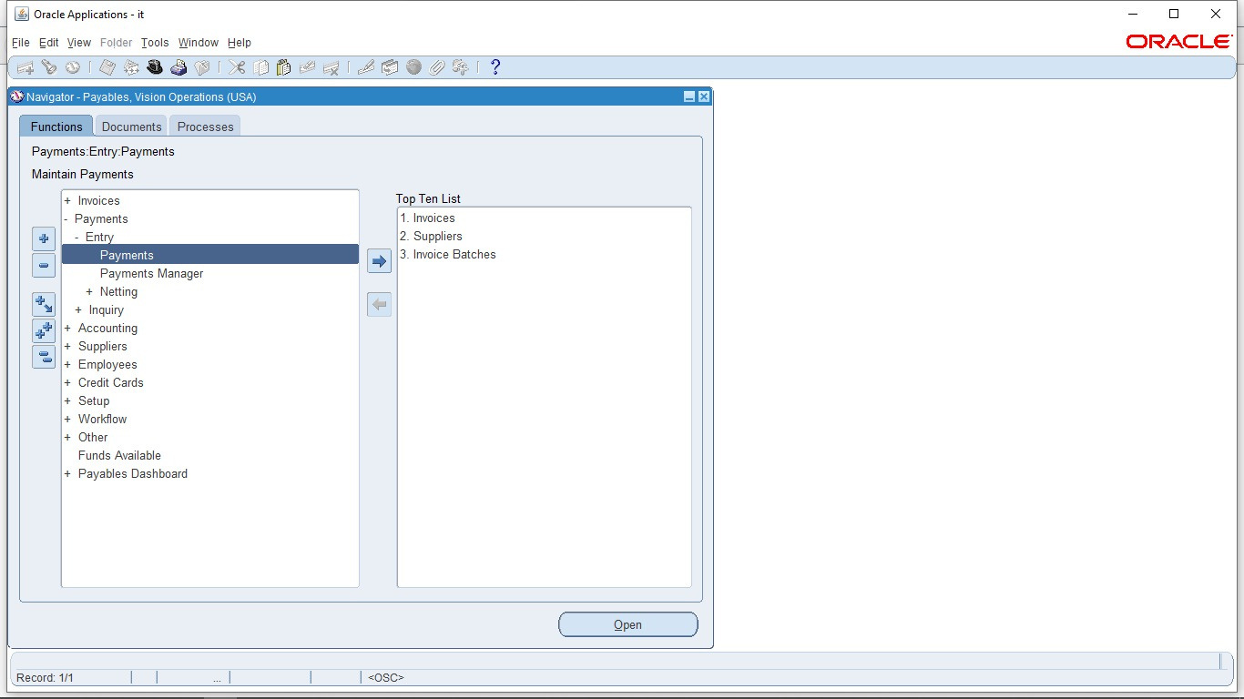
Payment Processing and Cash Management
Apply payments
2- Payment From Work Bench
Payments > Entry > payments
Type: Manual
and enter other details required
payment method: Wire
Then click on Enter/Adjust invoices
38

Slide 10
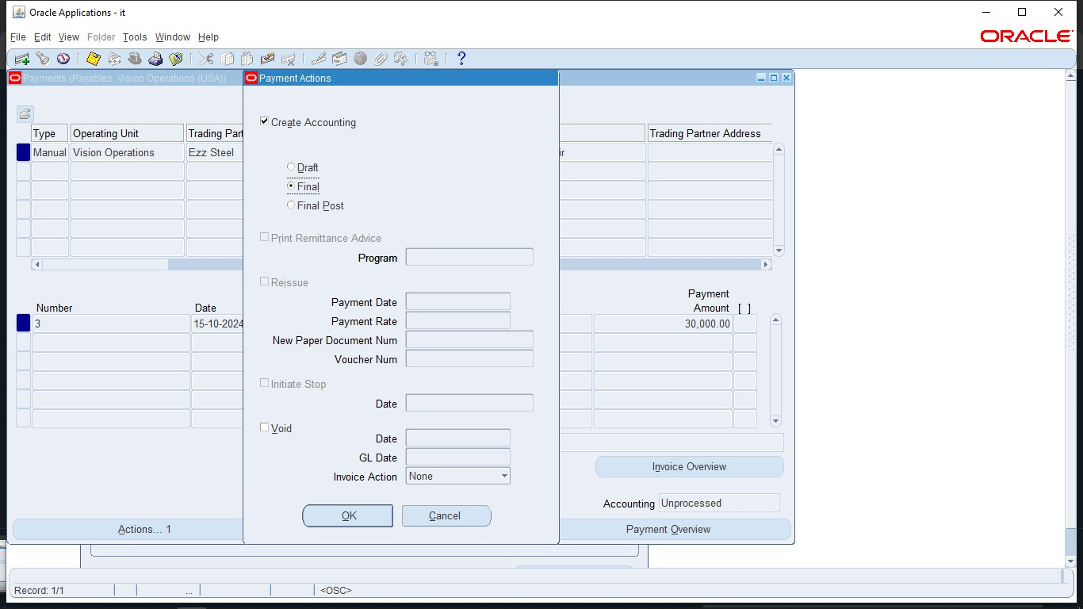

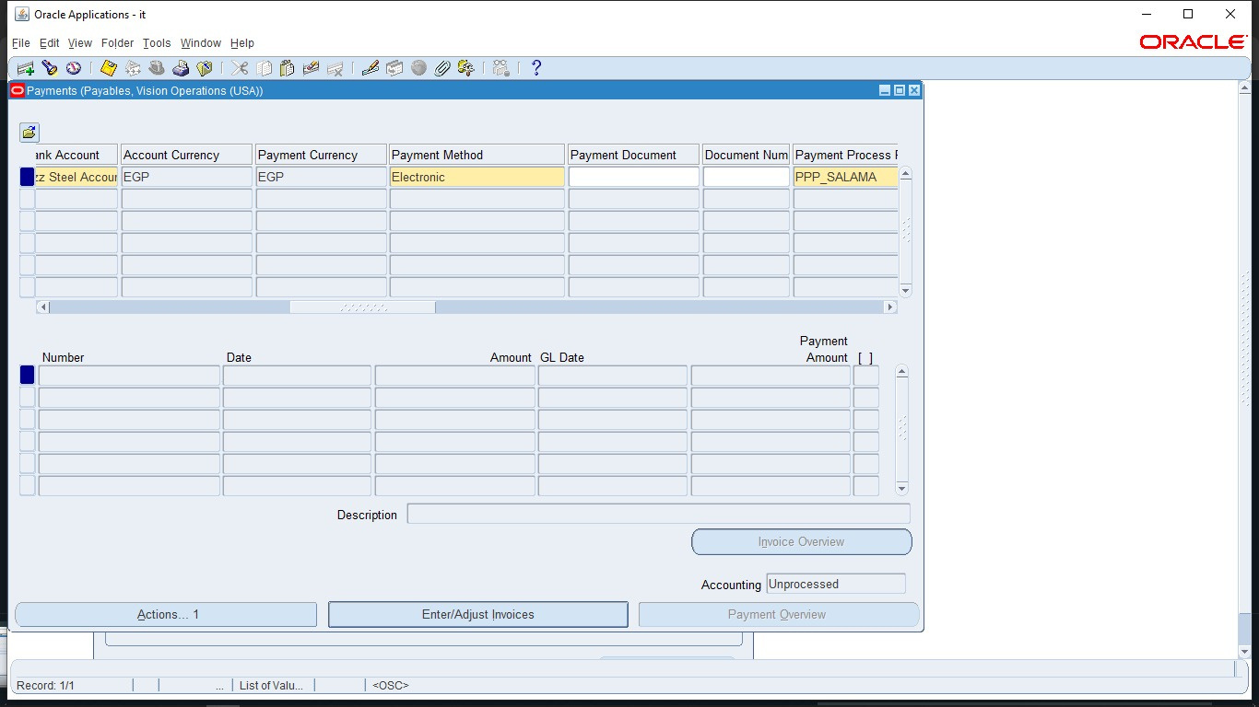
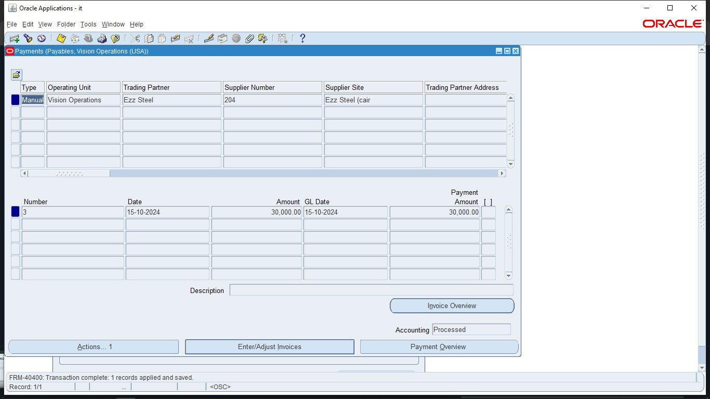
Payment Processing and Cash Management
Apply payments
2- Payment From Work Bench
After clicking on Actions ..1 button
Click on Create Accounting >Final
Also I can make a Payment Batch
Payment method: Electronic, Enter all details required, and click on Enter/Adjust Invoices
Enter any invoices you need to pay and save this action
39

Slide 11
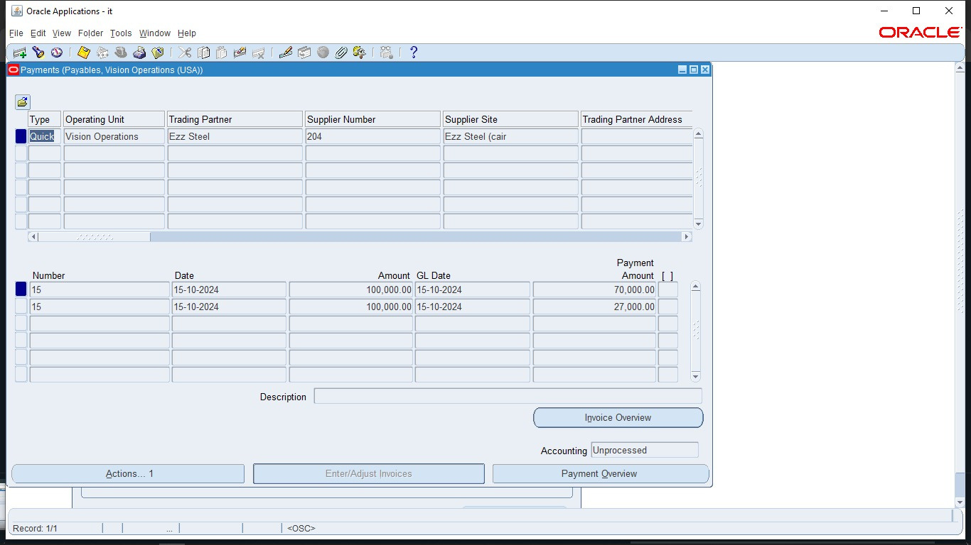
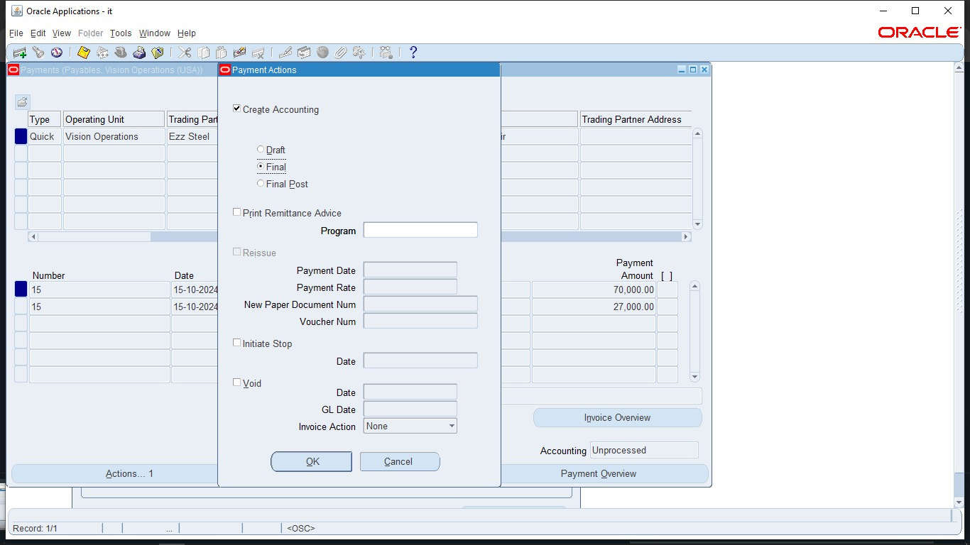
Payment Processing and Cash Management
Apply payments
2- Payment From Work Bench
The list of payments on invoices appear here and note that Accounting is Unprocessed
Click on Actions ..1 button
Choose Create Accounting check box > Final > Ok
then Accounting status will be Processed
40

Slide 12
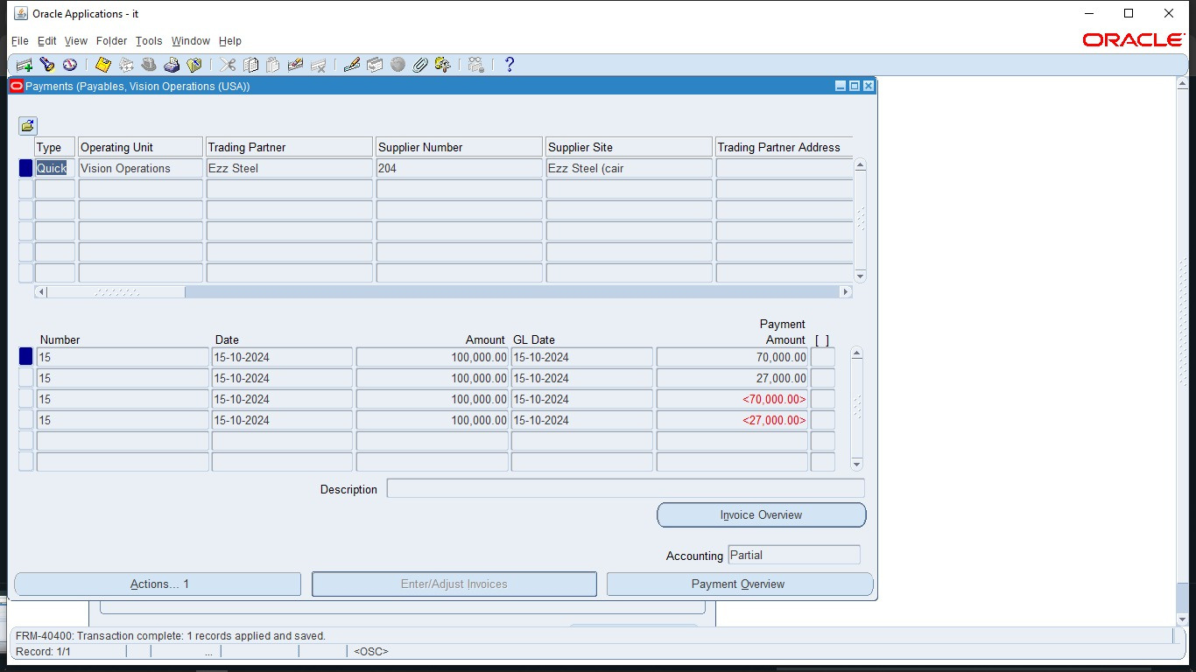
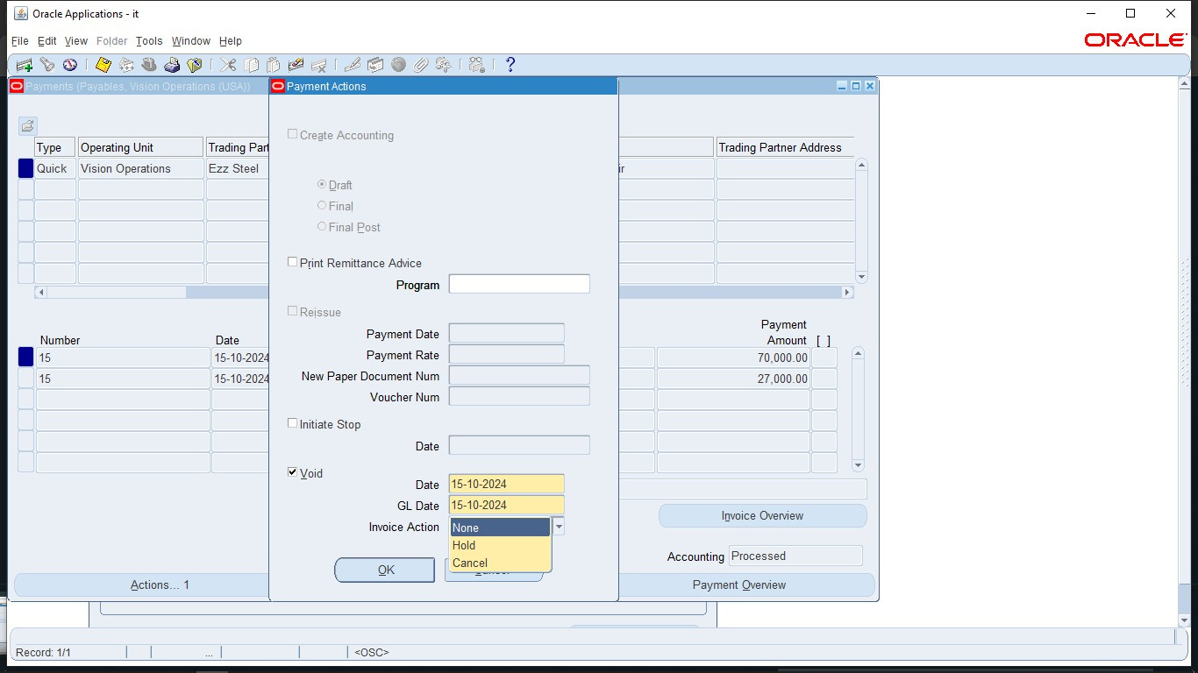
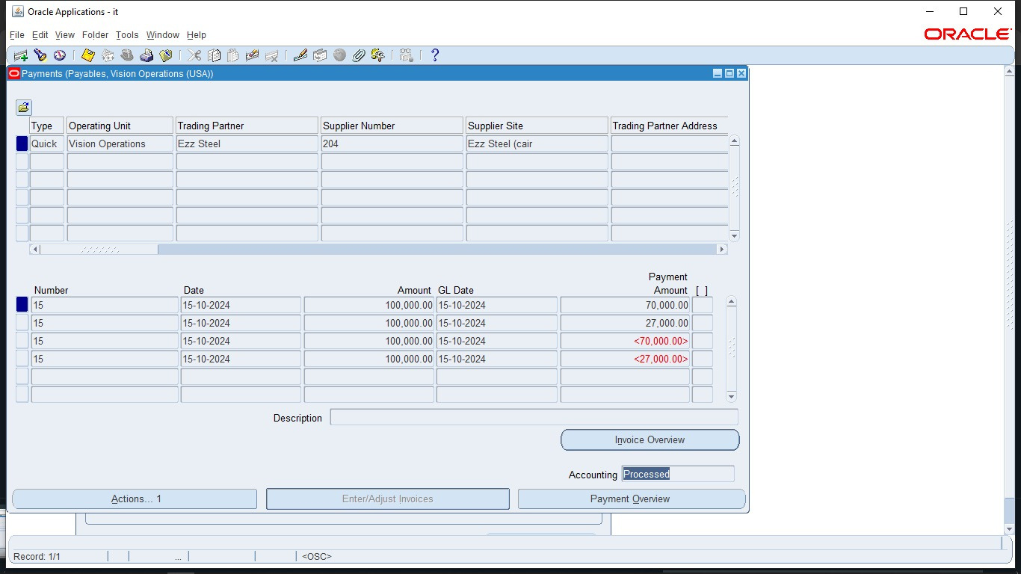
Payment Processing and Cash Management
Apply payments
2- Payment From Work Bench
I can void this payments from Actions ..1 button
Click on Void check box
Choose Invoice Action (None) to void payments only without hold or cancel its invoices > Ok
The payments is voided here
41

Slide 13
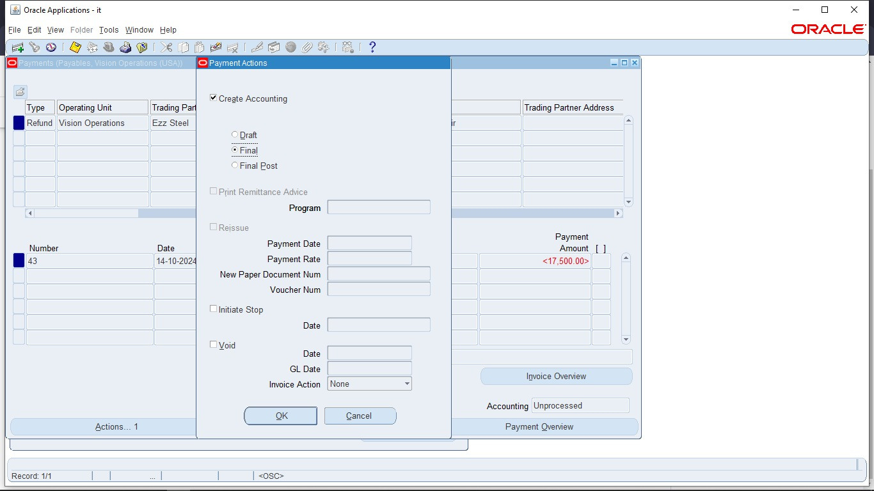
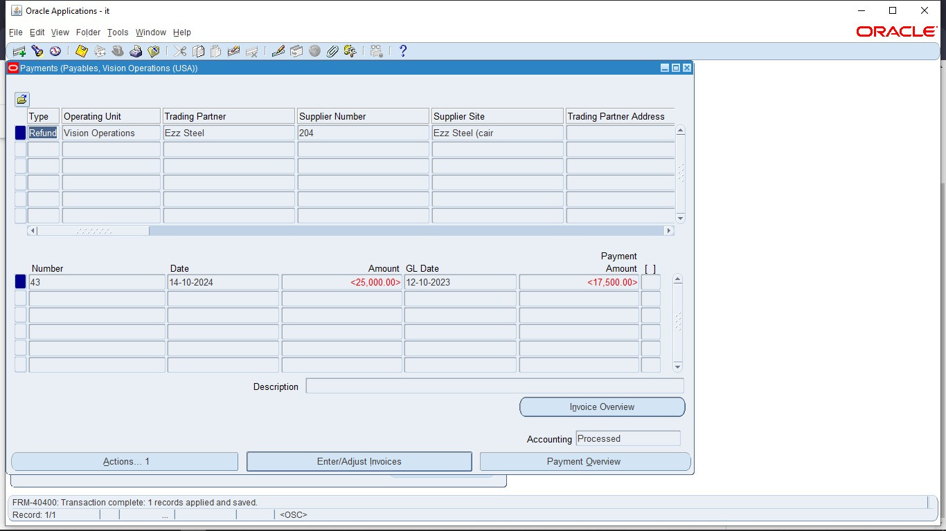
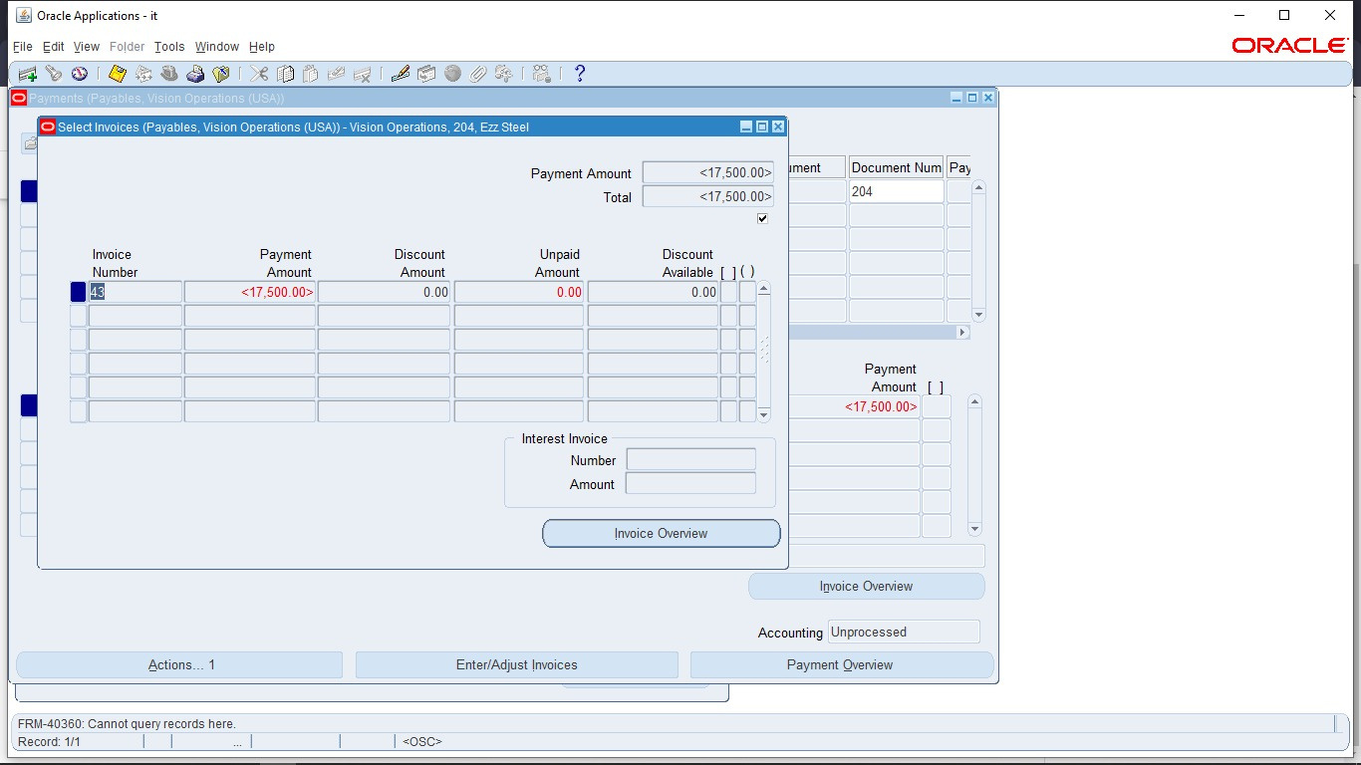
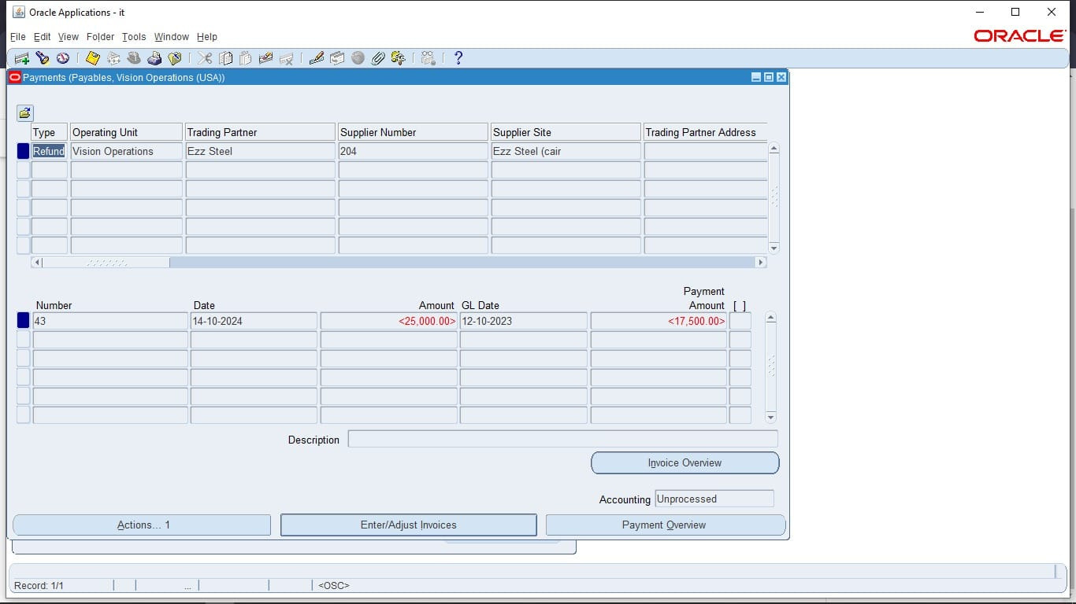
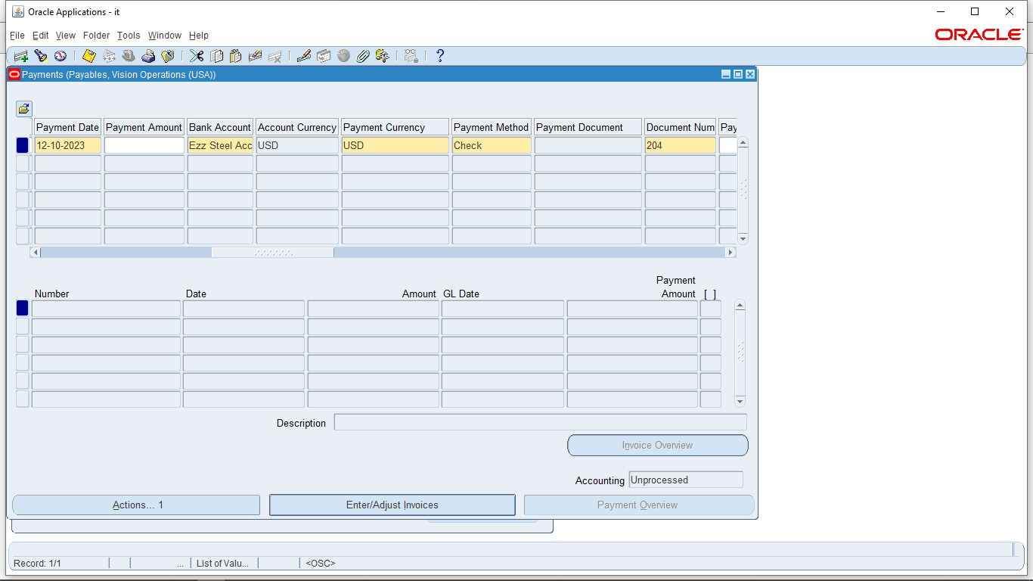
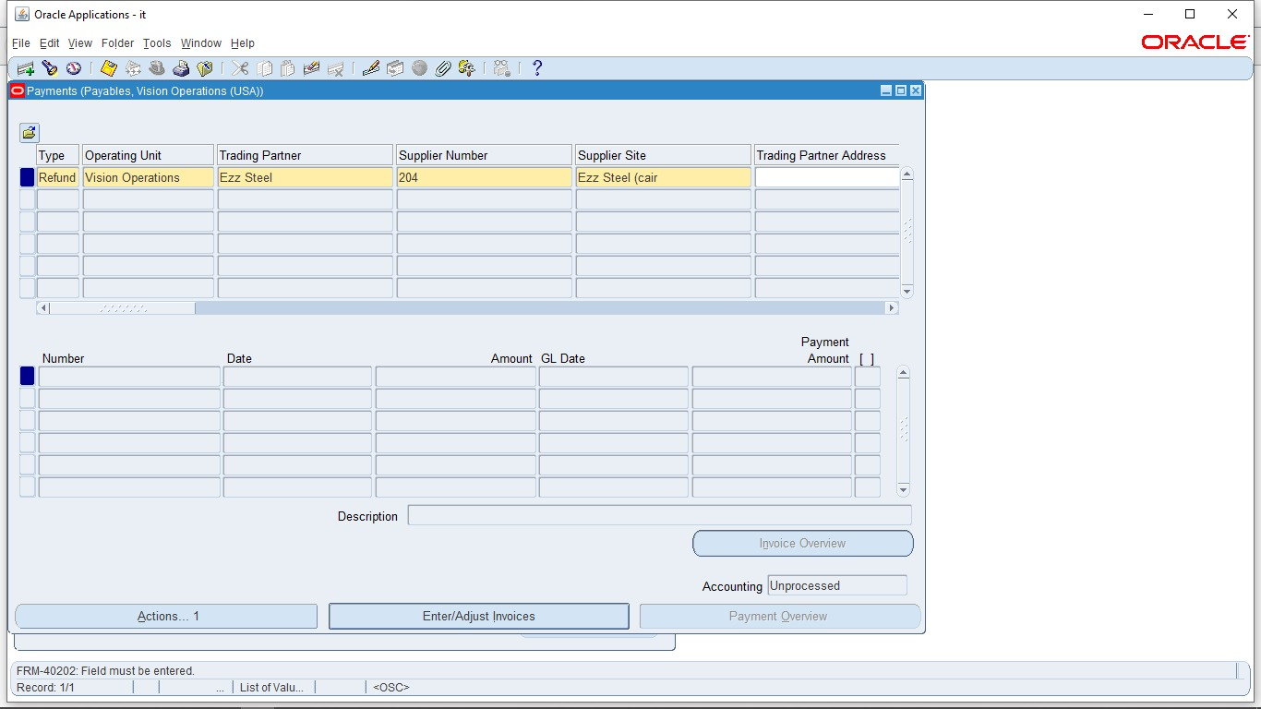
Payment Processing and Cash Management
Refund type
Enter other details
Enter the invoice you need to refund as negative amount and save action
The list of payments on invoices appear here and note that Accounting is Unprocessed
Click on Actions ..1 button
Choose Create Accounting check box > Final > Ok
then Accounting will be Processed successfully
42

Slide 14

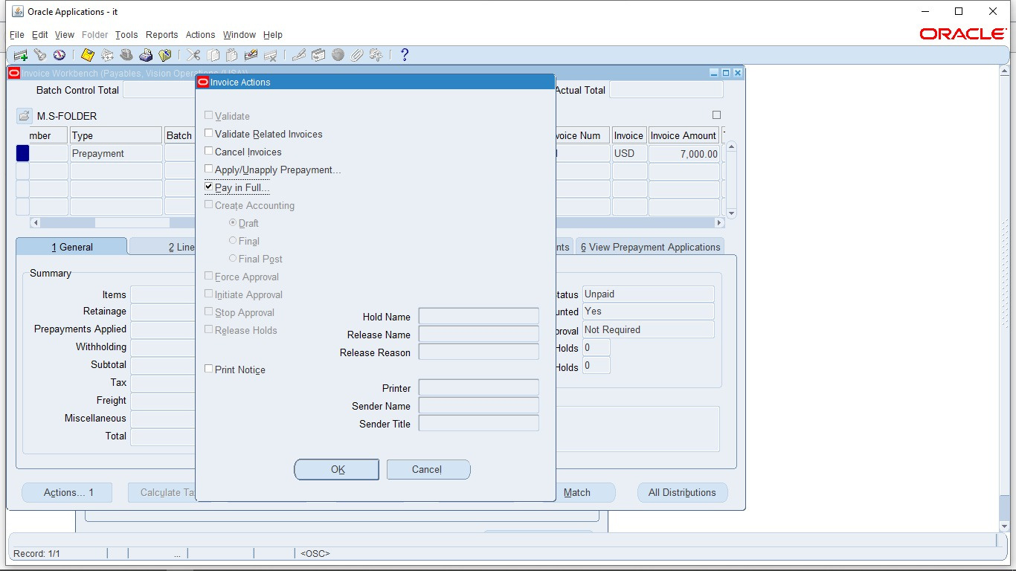
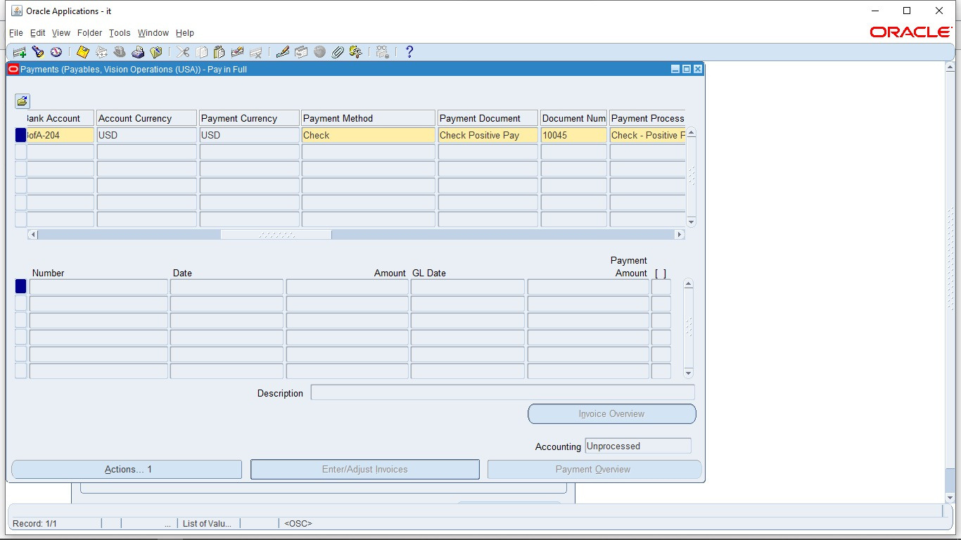
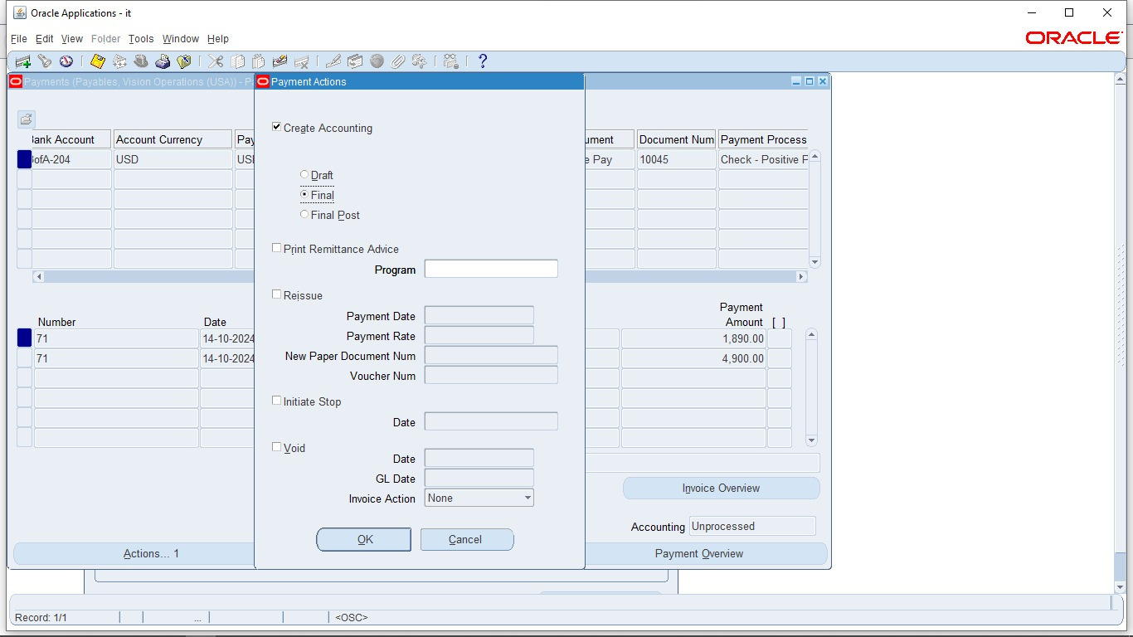
Payment Processing and Cash Management
Apply Prepayments
Identify the prepayment invoice
Click on Actions ..1 button
Choose Pay In Full from the check box > Ok
Enter details required in mandatory fields
Create Accounting check box > choose final and Ok
43

Slide 15
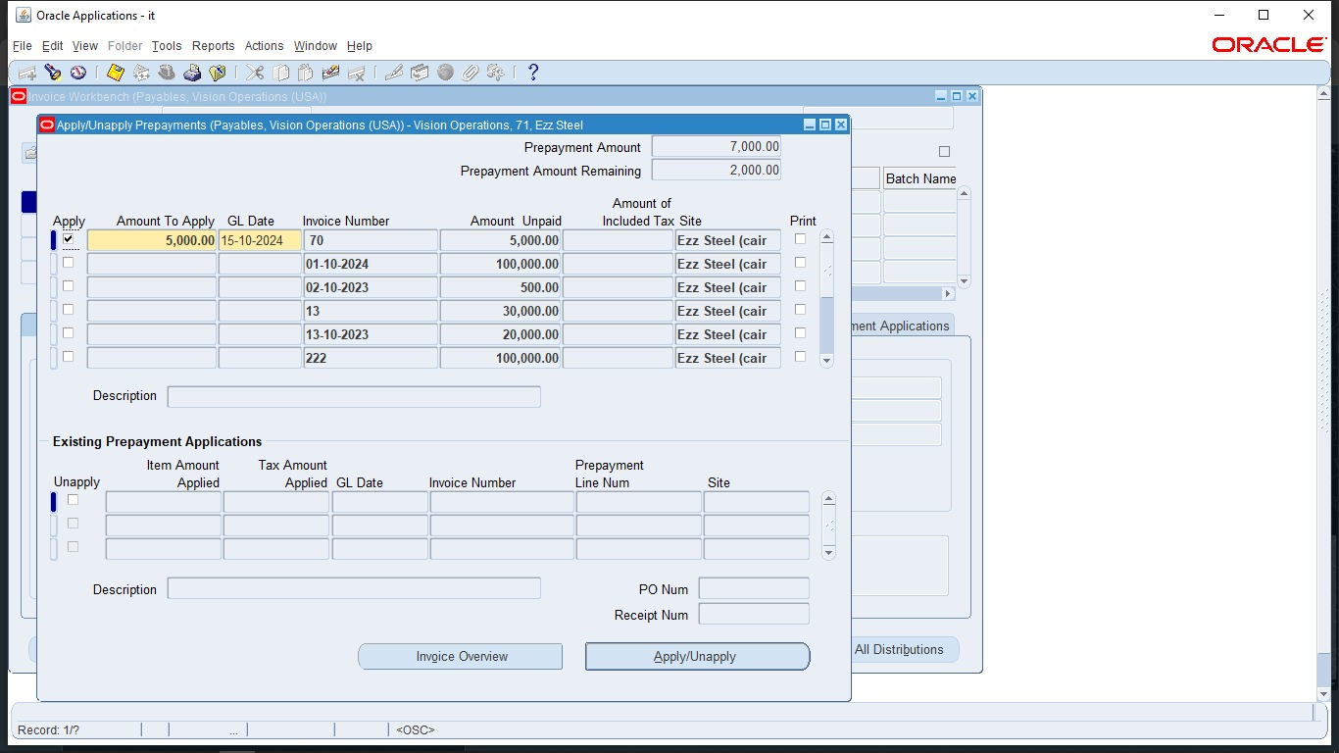
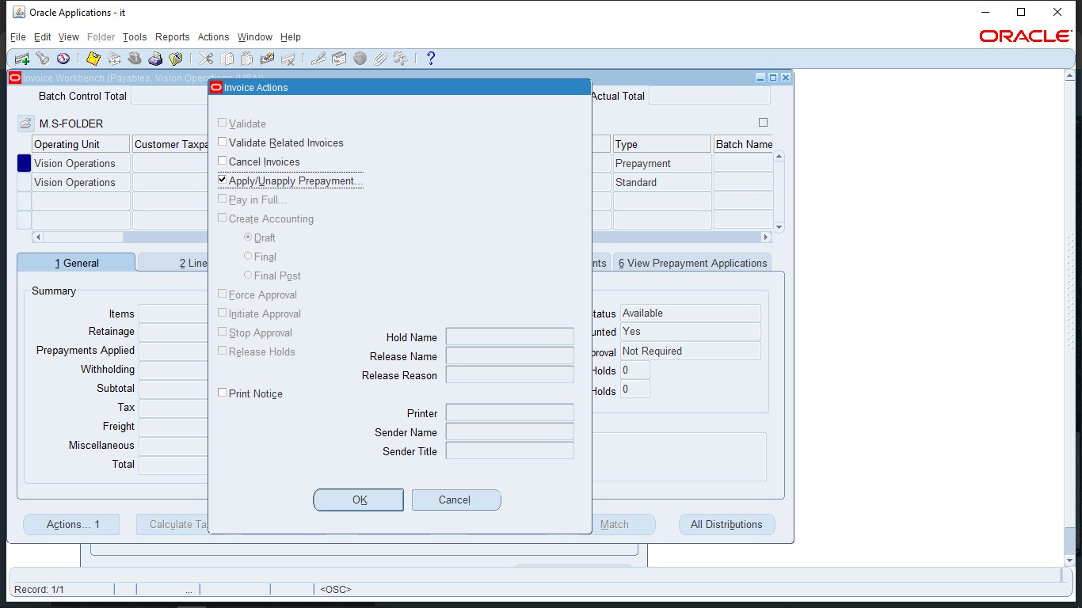
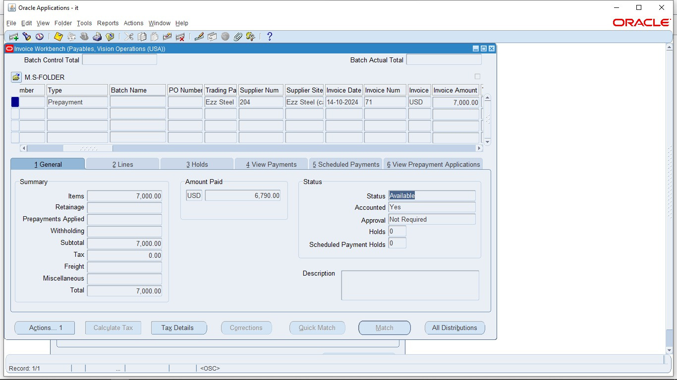
Payment Processing and Cash Management
Apply Prepayments
Back to prepayment invoice
Here, status become Available
Now I can apply the prepayment to other outstanding invoices
Click on Actions..1
Click on Apply/Unapply prepayment > Ok
Click Apply on the invoices you need to pay and enter the amount you want
44

Slide 16
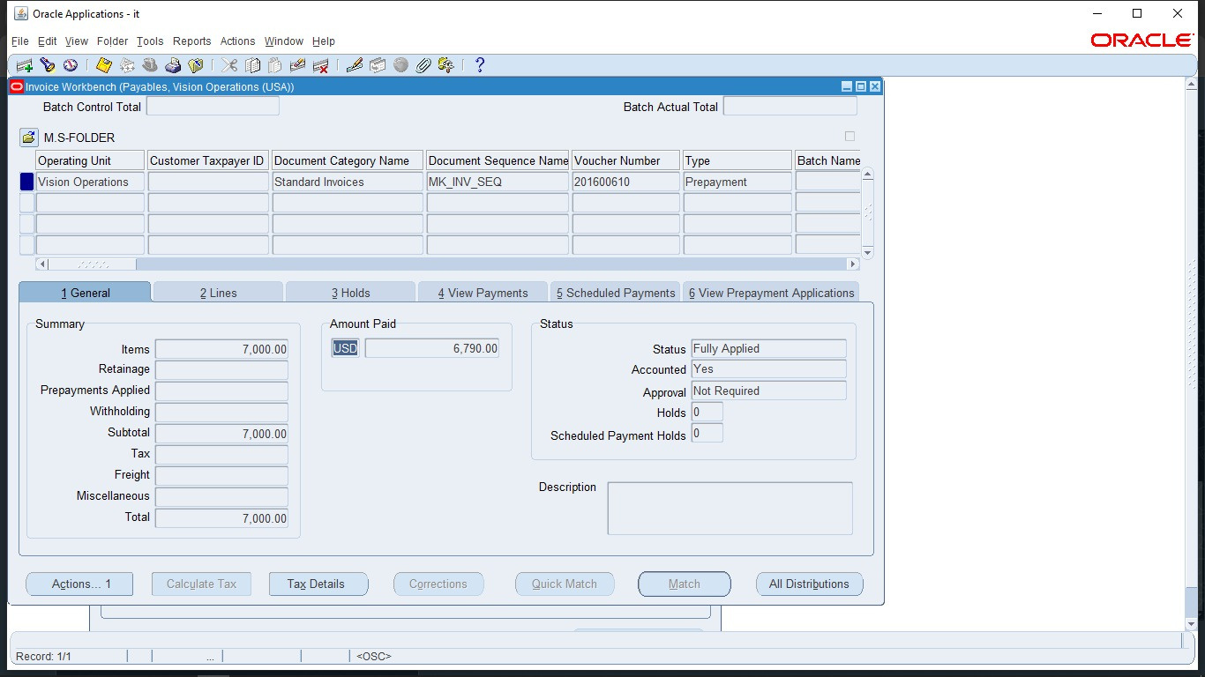
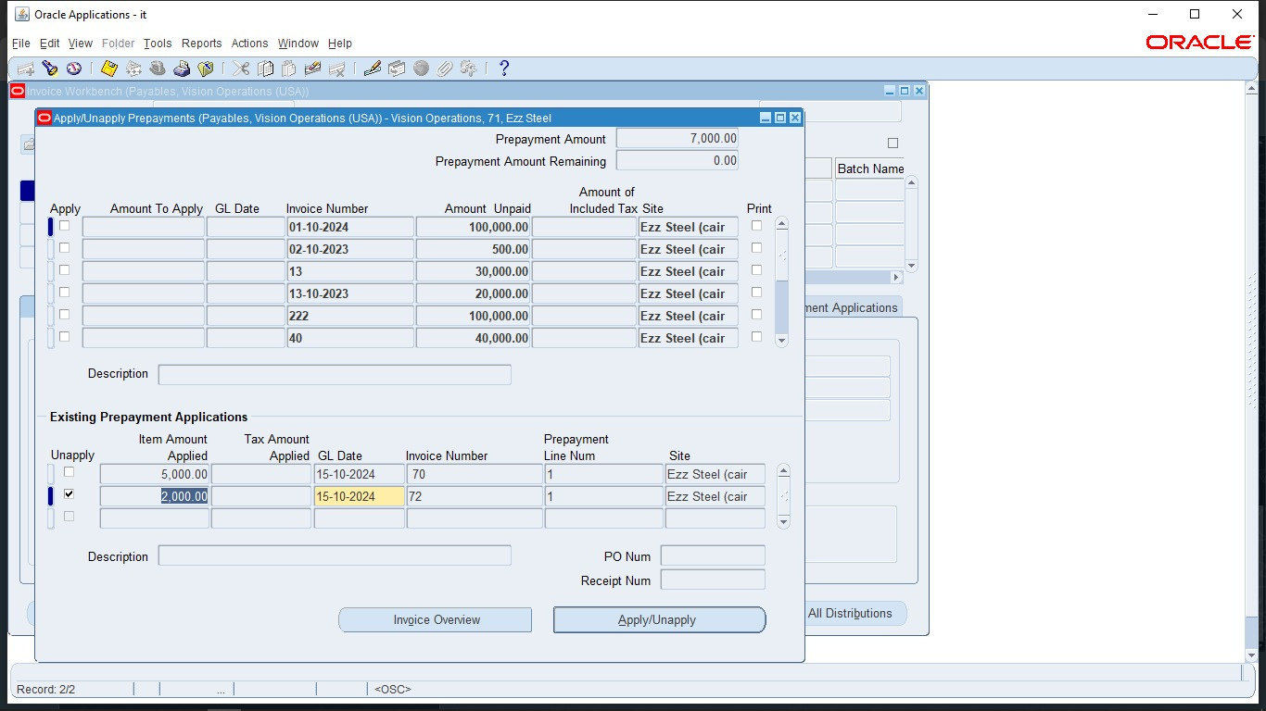
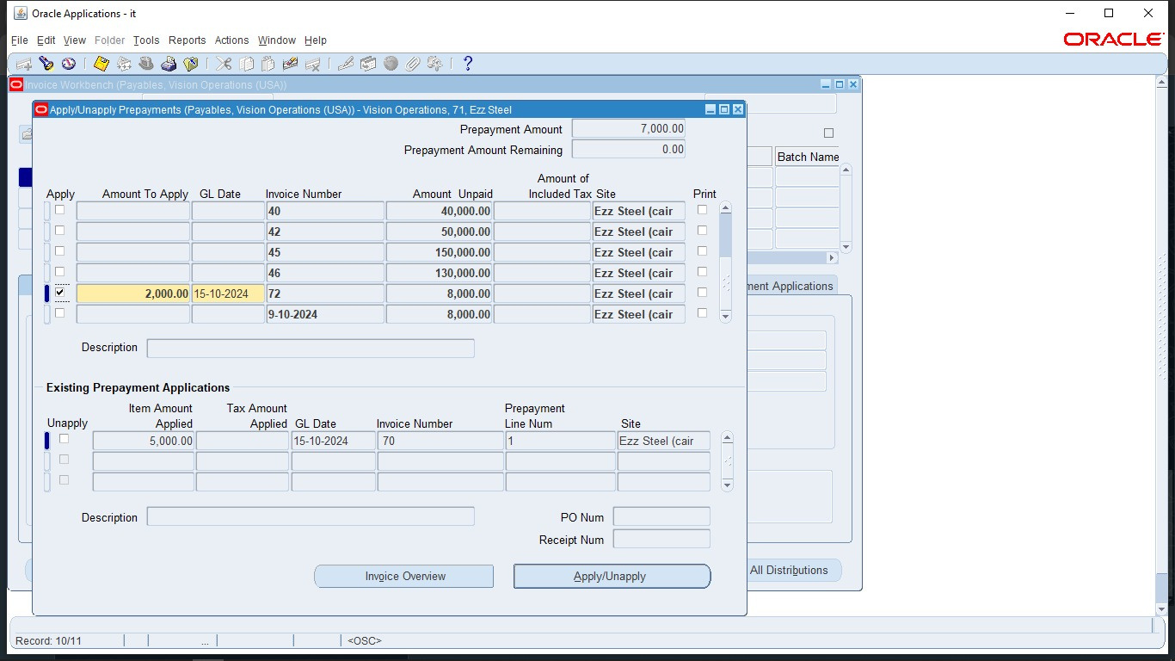
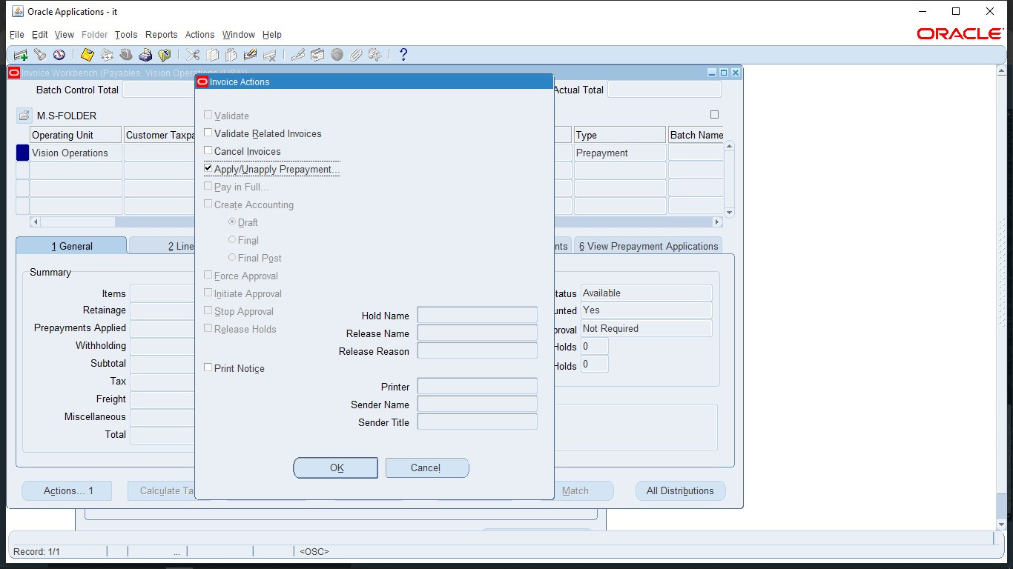

Payment Processing and Cash Management
Apply Prepayments
View Prepayment Application
Repeat the previous steps to apply the full amount of prepayment invoice
Here I can unapply prepayment on this invoice from the Unapply check box if I want
Back to the prepayment invoice
Note that the status become fully applied
45

Slide 17




Asset invoice
Create standard invoice
Click on 2 Lines, enter line amount and Charge it to asset clearing account
Swipe right
Click on track as asset check box
From Actions ..1 click on validate
46

Slide 18



Asset invoice
From Actions ..1 click on validate
Status become validated, then click on Actions ..1 again
Choose Create Accounting > Final
47

Slide 19








Period-End Closing and Reporting
Others >Requests >Run
Run Mass Additions create
Run Mass Additions Create Report
View output from Others >Concurrent
2 Requests completed
Then view output of Mass Additions Create Report
#

Slide 20



Period-End Closing and Reporting ​
View >Requests
Run Create Accounting Enter it's parameters
49

Slide 21


Period-End Closing and Reporting
Period Close Exceptions Report
50

Slide 22


Period-End Closing and Reporting
Transfer Journal Entries To GL
51

Slide 23


Period-End Closing and Reporting
Payables Vision Operations >Accounting > Control Payables Periods
52

Slide 24
Thank you for your attention.
We now invite any questions or feedback from you.
53

